Slide 1
Diabetic Ketoacidosis (DKA) Subcutaneous (SQ) Protocol-Physician Education

Slide 2
Diabetic Ketoacidosis (DKA)-Introduction
DKA is a common complication of diabetes with the potential for serious morbidity and mortality if not treated promptly. Characterized by:
Metabolic derangements result from the combination of absolute or relative insulin deficiency and an increase in counterregulatory hormones (glucagon, catecholamines, cortisol, and growth hormone).
1
Hyperglycemia
2
Ketosis
3
Metabolic Acidosis
Most DKA patients have Type 1 Diabetes BUT Type 2 Diabetes are also at risk during the catabolic stress of acute illness, such as trauma, surgery, or infections
2.4 billion
in costs annually &
US hospital admissions for DKA have increased 6.3% (CDC)
Mortality:
<5%
in the young (<40 yo) &
>20%
in the elderly
Notes:
1 event per year for every 7 pump patients.

Slide 3
Why SQ DKA Protocol
Simplify delivery, with potential of reducing error
Reduce need for ICU admission
Decrease nursing work
Reduce hourly glucose checks
Will reduce cost & avoid excess length of stay
=
Combination of rapid acting and long action SQ insulin shown to be just as effective
Appropriate utilization of ICU while not compromising on patient safety
Notes:
Many DKA patients reverse quickly and are in ICU for short periods of time (typically transferring out the next day)
Not much cost difference between Insulin Drip and SQ insulin (there is labor cost and use of resource)
Transitioning from insulin drip to a SQ regimen is imperfect (can increase length of stay)
Better drugs now, why not utilize them?

Slide 4
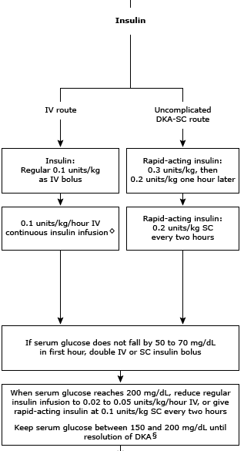
Side-By-Side: IV vs SQ
ADA GUIDELINES (2009)
UP TO DATE GUIDELINES (2018)
Key Difference:
IV vs SQ
Notes:
Indicates that there is an SQ arm in the UpToDate guidelines. ADA is from 2009 so somewhat outdated.

Slide 5
Treatment of Diabetic Ketoacidosis with Subcutaneous Insulin Aspart

Slide 6
Prospective Randomized Trial of Insulin Glargine in Acute Management of DKA in the Emergency Department: A Pilot Study

Slide 7
SQ DKA Protocol
Notes:
This protocol was initially developed and implemented in SJO in 2016, later spread to SC 2019 and Richmond 2020.
Now implementing regionwide this April 2021.
Overall findings from the sites showed:
No impact on
mean total insulin dosage in first 48 hours
the incidence of hypoglycemia events
30-day mortality among patients
Overall, 55% relative decrease in the need for intensive care at intervention sites and a 42% relative decrease in the rate of 30-day readmission, adjusted for patient characteristics.

Slide 8
Management of Adult DKA: When to use the SQ Protocol?
Review all previously ordered insulin and discontinue oral hypoglycemic agents before using this orderset
ICU
Med/Surg +/- Tele
Admit to ICU if patient is:
Hypotensive
GCS < 8
Any other medical conditions that normally would require ICU admission
Otherwise admit patient to Med/Surg +/- Telemetry as clinical judgment warrants
Consider using the DKA/HONK IV Insulin orderset if admitting the patient to the ICU

Slide 9
When to use the SQ Protocol?
For use in Mild and Moderate DKA (without any evidence of coma/AMS)
Mild | Moderate | Severe
pH 7.25 and 7.30 Bicarbonate 15 - 18 Person is alert | pH 7.00 - 7.25 Bicarbonate 10 - 15 Mild drowsiness may be present | pH below 7.00 Bicarbonate below 10 Stupor or coma may occur
Use the DKA/HONK IV Insulin orderset for patients with Hyperosmolar Hyperglycemic state
Use clinical judgement to determine volume status.
Fluid management based on volume status (just as in the standard ADA protocol)
Notes:
This protocol is for mild to mod DKA, how is this define?

Slide 10
Why should we use the SQ DKA protocol?
Safe for patients
Decreases the number of required glucose checks
Less nursing work and less patient discomfort
Decreased hypoglycemic episodes
Decreases rebound hyperglycemia by introducing long-acting insulin early
Decreases need for ICU admission
Decreases 30-day readmission

Slide 11
When should the patient go to ICU instead?
Other physiological condition (e.g. septic shock) that requires ICU level of care
Patient stuporous, comatose, GCS < 8 (concern for airway protection)

Slide 12
DKA Management: Tenants of Treatment
Correction of electrolyte derangements
Treatment of precipitants
Management involves:
IV fluids
Insulin
Treatment | Purpose
Fluids | Optimize perfusion + Expand interstitial and intracellular volume + reduce glucose
Electrolyte replacement | Total body deficits of K, Mg, and Phos
Bicarb Therapy | Controversial, no benefits shown
Insulin Therapy | Correct hyperglycemia + Halt lipolysis + ketogenesis
Notes:
Here are the main tenants of treatment which most of us known. It revolves around hydration to expand interstitial/intracellular and decrease hyperosmolarity. Electrolyte replacement as you have total deficits. Insulin therapy is a staple to halt ketogenesis. I added bicarb here but we know it is controversial. Same tenants are in the DKA SQ protocol

Slide 13
DKA Treatment: Electrolytes
Initial
Check K ⁺ and replace if low, prior to giving insulin
Provider will order IVF with KCL if K⁺ <5.5
When to Add
Add K⁺ to IVF’s when
K⁺ <5.5 (< 4.5 for renal patients)
Frequency of Monitoring
Q4 hr Chem 7, Mag, and Phos until DKA resolves
Replacement orders in SQ DKA order set
Notes:
Check rate of K repletion with 10 vs 20 K
Check protocols

Slide 14
SQ Non-ICU Protocol
Management in ED: LR Bolus x 2L ASAP then LR @ 500 mL/hr for a total of 5L Lantus 0.3 units/kg SQ x 1 or patient’s usual home dosage Lantus SQ Lispro 0.3 units/kg x 1. Do not give if glucose is <250. Repeat dose in 4 hours if glucose is still > 250. D5+0.45% NaCl + KCl at 40 mEq/L @ 150 mL/hr (if K > 5.5 then start D5+0.45% NaCl w/o K+) Start two IV lines; LR and D5+0.45% NaCl should be running at the same time Monitor glucose q2 for 4 hours after last dose of high dose Lispro given then q4
Management in Med Surg/Tele Lispro SQ 0.2 units/kg q4 until glucose < 250 then call MD for SSI Continue D5+0.45% NaCl + KCl at 40 mEq/L @ 150 mL/hr (if K > 5.5 then continue D5+0.45% NaCl w/o K+) Continue LR at 500 ml/hr for a total of 5 L (if not finished in ED) Lantus 0.3 units/kg or patient’s usual dose 24 hours after first dose Follow chem7, PO4, Mg q4h Monitor glucose q2 for 4 hours after last dose of high dose Lispro given then q4 KCl 40 mEq for K < 4 either IV infusion or PO NaPO4 20 mmol IV for PO4 < 2 Mg 2 gm IV for Mg < 2 Diabetic clear diet advance as tolerated Consider carbohydrate counting for Type 1 After glucose < 250 MD orders SQ insulin sliding scale and home dose of insulin. Discontinue q4 Lispro SQ.
Discharge Recommendations: Once DKA is resolved, if newly diagnosed Type 1 or suspected Type 1 continue Lantus at discharge If new type 1 diabetic patient, send E-consult to endocrinology clinic at time of discharge If known type 1 diabetic patient, discharge on home dose of insulin. Send staff message to P STR END MD. If known type 2 diabetic patient, discharge on home DM medications and patient to follow up with primary care physician or PHASE pharmacist
Notes:
Note: Patients get initial dose of insulin and then can be moved to another floor (additional information to last bullet in ED section)

Slide 15
Phase 1 – Management in the Emergency Department
PHASE 1 | Management in the Emergency Department
Standard IV fluids | Lactated ringers bolus of 2 Liters, followed by Lactated ringers at 500 mL/hr for a total of 5 liters
Dextrose fluids
If K ≤ 5.5 | Dextrose 5% (D5) + 0.45% NaCl + KCl at 40 mEq/L @ 150 mL/hr
If K > 5.5 | Dextrose 5% + 0.45% NaCl without potassium @ 150 mL/hr
Long-acting insulin | SQ Glargine 0.3 units/kg x 1 or the patient’s usual home dosage Lantus
Rapid-acting insulin | SQ Lispro 0.3 units/kg x 1. Do not give if glucose is <250 mg/dL. Repeat dose in 4 hours if glucose is still > 250.
If glucose ≥ 250 | SQ Lispro 0.3 units/kg x 1; repeat 0.2units/kg dose in 4 hours if glucose remains >250. Do not give if glucose < 250.
Glucose monitoring | Monitor glucose every 2 hours for 4 hours after last dose of high dose Lispro given then every 4 hours
Other | Start 2 peripheral IV lines
Notes | LR and D5+0.45% NaCl should be running at the same time

Slide 16
Phase 2 – Management in CDA, Medical wards, Telemetry
PHASE 2 | Management in Clinical Decision Area, Medical wards, or Telemetry
Standard IV fluids | Continue LR @ 500 mL/hr for a total of 5 liters (if not finished in the ED)
Dextrose fluids
If K ≤ 5.5 mEq | Continue Dextrose 5% (D5) + 0.45% NaCl + KCl at 40 mEq/L @ 150 mL/hr (for upto 6-10 hours after the high dose lispro depending on the PO intake)
If K > 5.5 | Continue Dextrose 5% + 0.45% NaCl without potassium @ 150 mL/hr (for upto 6-10 hours after the high dose lispro depending on the PO intake)
Long-acting insulin | SQ Lantus 0.3 units/kg or patients’ usual dose 24 hours after 1st dose
Rapid-acting insulin | SQ Lispro 0.2 units/kg every 4 hours until glucose < 250 mg/dL. When glucose <250, call MD for insulin sliding scale and discontinue q4h lispro
If glucose ≥ 250 | SQ Lispro 0.2 units/kg every 4 hours until glucose < 250 mg/dl
If glucose < 250 | Call physician for insulin sliding scale and discontinue every 4 hour SQ lispro. Start home dose of insulin
Glucose monitoring | Monitor glucose every 2 hours for 4 hours after last dose of high-dose SQ Lispro given; then every 4h
Electrolyte monitoring
Potassium | KCl 40 mEq for K < 4; can give either IV or PO
Phosphorus | NaPO4 20 mmol IV for PO4<2
Magnesium | Mg 2 gm IV for Mg < 2
Diet | Advance diet to diabetic clear diet as tolerated. Consider carbohydrate counting for patients with type 1 diabetes D5 IVF will continue for up to 6hrs after last high dose lispro (to reduce risk of hypoglycemia)

Slide 17
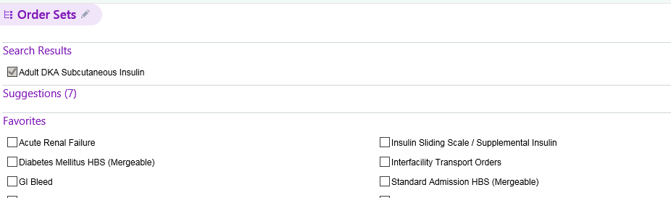
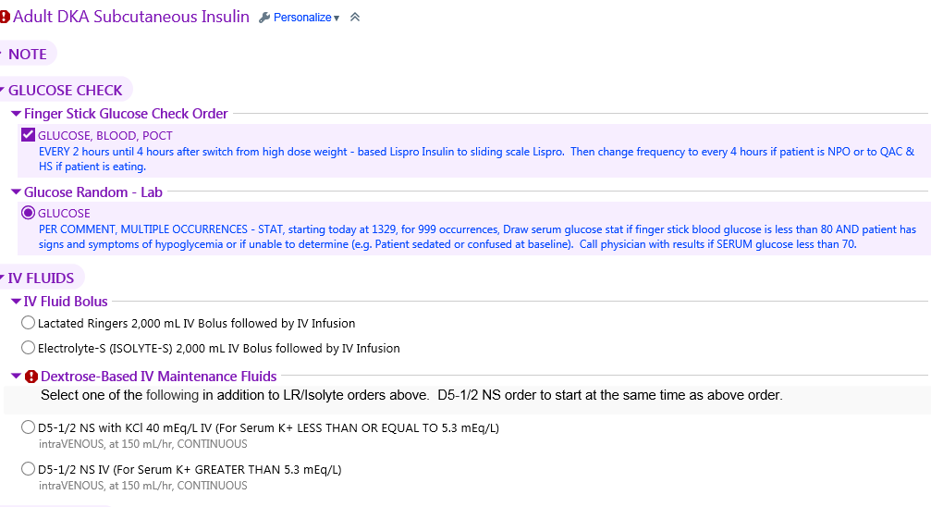
DKA Order Set
DKA SQ Order Set

Slide 18
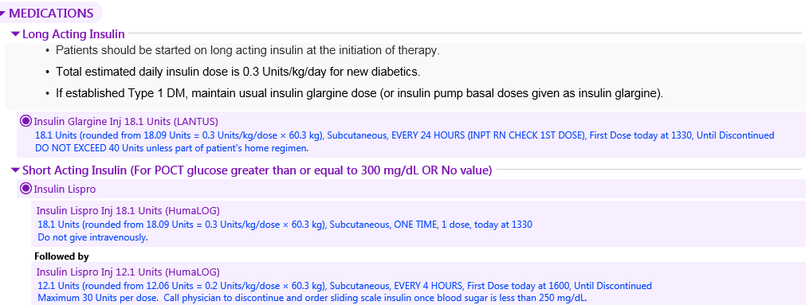
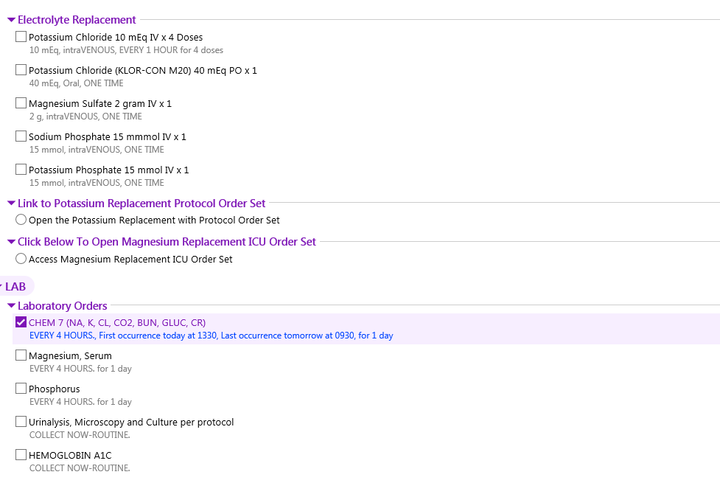
DKA Order Set (Cont.)
DKA SQ Order Set

Slide 19
DKA Order Set (Cont.)
DKA SQ Order Set

Slide 20
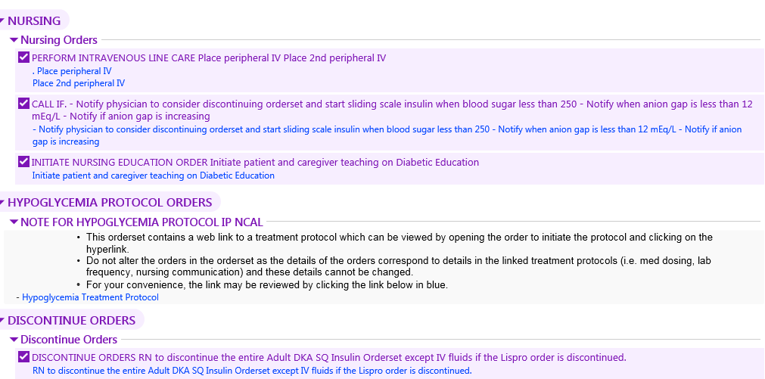
DKA Order Set (Cont…)
DKA SQ Order Set

Slide 21
FAQs
What should we do if the patient was started on IV insulin in the ED but they look like a SQ DKA candidate?
There is no definitive process. Options are:
If only a dose of IV regular insulin has been given, switch to SQ protocol and adjust the dose of Lispro OR
For a patient on IV infusion, repeat labs, assess glucose, lytes, and anion gap, then consider switching OR
Continue the IV protocol and give feedback to physicians to use SQ the next time
What about patients with Euglycemic DKA (e.g. SGLT2i in T1D)?
For patients with EDKA, do not give the high dose Lispro in the SQ protocol
Administer Lantus and start on insulin correction protocol and rest of the orders as per the SQ DKA protocol (e.g electrolytes and glucose monitoring)

Slide 22
FAQs Continued
Is there a maximum weight limit for this protocol?
Yes, 133 kg. Use Insulin Infusion Protocol for > 134 kg
The order set has a maximum of 40 units Lantus per dose (40/0.3= 133 kg)
What about patients with ESRD or renal transplant?
Adjust fluids and insulin with special circumstances, such as end-stage renal disease, heart failure, or BMI > 40
Can this be used for Insulin Pump—Continuous Subcutaneous Insulin patients in DKA?
Yes, unless they need ICU level of care as per the SQ DKA protocol (insulin infusion protocol in that case)

Slide 23
Special Considerations

Slide 24
Euglycemic DKA-(EDKA/euDKA)
It should be suspected in any diabetes patients who is on SGLT2i with classic symptoms
Diagnosis can be made with the classical cutoff level of pH, HCO3 and ketone with normoglycemia
Many studies have shown evidence that use of SGLT2i in T1D and in LADA cases have higher incidence of EDKA
Reduced carbohydrate intake, depleted glycogen reserve due to alcoholism, SGLT2i in T1D, reduction of insulin might precipitate EDKA
Do not give High dose Lispro in SQ protocol in patients with EDKA

Slide 25
DKA in Patients with Insulin Pump: Continuous subcutaneous insulin infusion (CSII)
Pumps use only rapid-acting (short-acting) insulin that starts working in 10 to 15 minutes and lasts 4 to 5 hours in most people.
Blood glucose levels can start rising very quickly and cause DKA if:
• A pump is disconnected for more than 1 to 2 hours
• A pump malfunctions (does not work correctly)
• There are problems with an infusion set
Do not use the CSII if patient has DKA.
SQ protocol should be used depending on severity of the DKA.
SQ protocol works very well as Glargine mimics physiological basal insulin secretion

Slide 26
Thank You

